Slide 1
Rotor Hub And Pitch System
Group Members :
Dhruvin Kakdiya
Adharsh Pappinisseri Veedu
Muthu Thirunavukarasu
Syed Mohammed Sikandar
Week number : 09
Date: 25/11/2025
Supervisor: Prof. Peter Quell
Syed Mohammed Sikandar

Slide 2
List of Contents
Updated CAD Model of Blade Bearing
Brake Torque Assumption
3. Reworked Grease Calculation
Syed Mohammed Sikandar

Slide 3
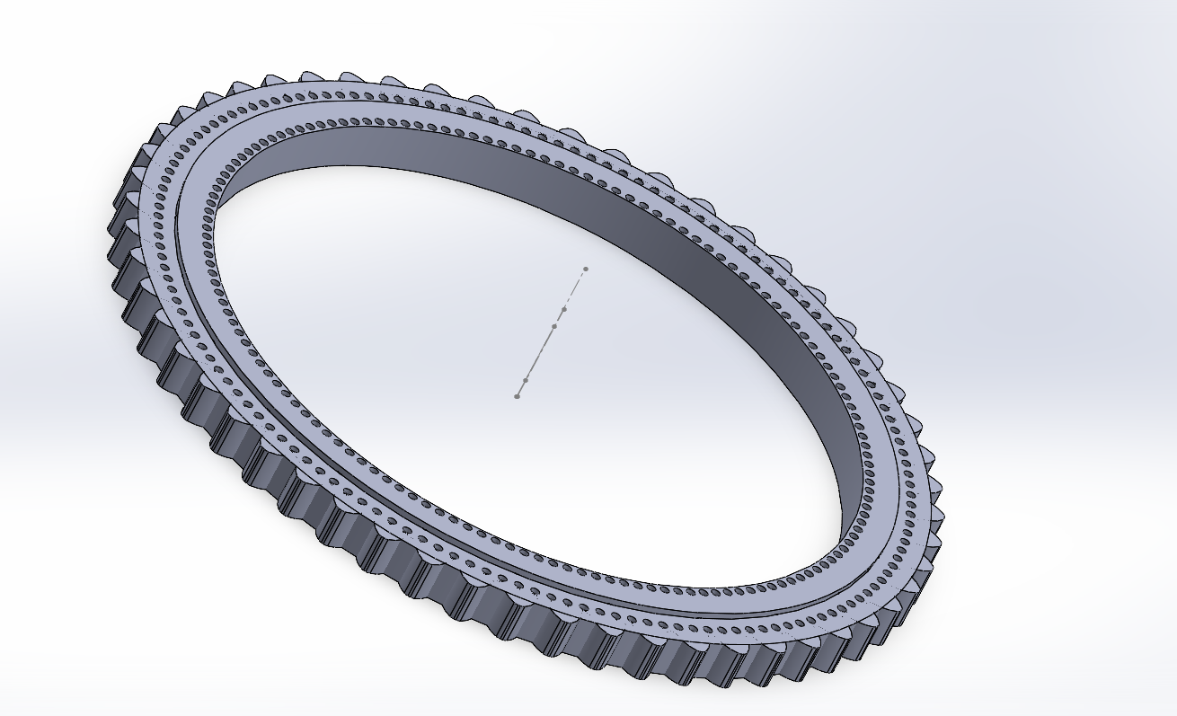
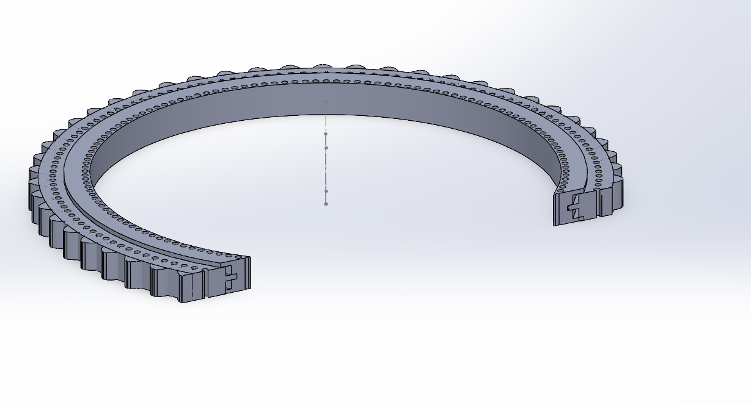
Updated CAD Model of Blade Bearing
Orthographic view
Sectional view
Fig. 1 : Outer ring rotating triple row roller bearing (Assembly) with change in gear teeth dimensions
Syed Mohammed Sikandar

Slide 4
Material Specification
Component | Typical Material | Key Property
Bearing rings | 42CrMo4 | Strength + fatigue resistance
Rollers | 100Cr6 | Very high hardness & fatigue life
Cage | Brass or low-carbon steel | Strength & stability
Syed Mohammed Sikandar

Slide 5
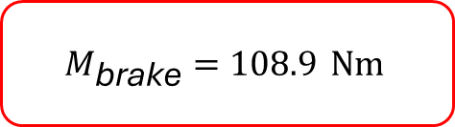

Maximum Brake Torque
$$M_{\text{brake}}=\frac{MzB}{\text{ibearing}\text{​}\text{⋅}\text{igear}\text{​}}×\text{η}\text{bearing}\text{​}×\text{η}\text{gear}\text{​}$$
$$M_{\text{brake}}=\frac{370}{13.81×217.2}×0.95×0.93$$
$$M_{\text{brake}}=108.9 Nm$$
Syed Mohammed Sikandar

Slide 6
Grease Volume Calculation
Amount of Grease Required = Volume of 3 Raceway − (Volume of Roller × Number of Rollers)
Earlier we found the Grease volume using the above formula as V​Grease = 55.62−24.59=31.03 L. But, the bearing cage occupy physical volume inside the raceway. In our earlier calculation we subtracted roller volume from the annular volume, but we did not subtract cage/pocket volume.
So, that missing cage volume reduces the free annular volume available for grease → less grease required than we calculated.
Syed Mohammed Sikandar

Slide 7
We assumed a cage-occupancy factor of 15%
Subtract cage pockets (15%)
Filled grease mass at 80% fill
Annual relub (50% of filled mass)
Pitch bearing gear: Requires 5.00 kg/year
Total Annual Requirement
VGrease​=31.03×(1−0.15)=31.03×0.85=26.375 L
M​=​ VGrease​ ×ρ× Fill fraction =26.375 L×0.90 Lkg​×0.80=18.990 kg
18.990×0.50=9.495 kg/year
(11.17 kg+5.00 kg)=14.495 kg/year
Syed Mohammed Sikandar

Slide 8


Grease Volume for Maintenance Interval
For a 6-month operational period
Monthly consumption:
Grease for 6 months (per bearing)
For 3 identical bearings (total)
14.495 kg /12 = 1.207 kg/month
$1.207×6=7.24$ kg
7.24 kg$×3=\text{2}\text{1}\text{.}\text{72}$kg
Syed Mohammed Sikandar

Slide 9
Bibliography
[1] SKF — Determining grease quantities & general bearing lubrication guidance, SKF Publication
[2] SKF, “Windlub: Lubrication management for wind energy,”SKF, Nov, 23, 2025, Available:
https://www.skf.com/group/industries/wind-energy/operation-and-maintenance/windlub Nov 23,2025

